Slide 1
Drone Phenology Monitoring
Gaurav Rajput
Parth Thakur

Slide 2
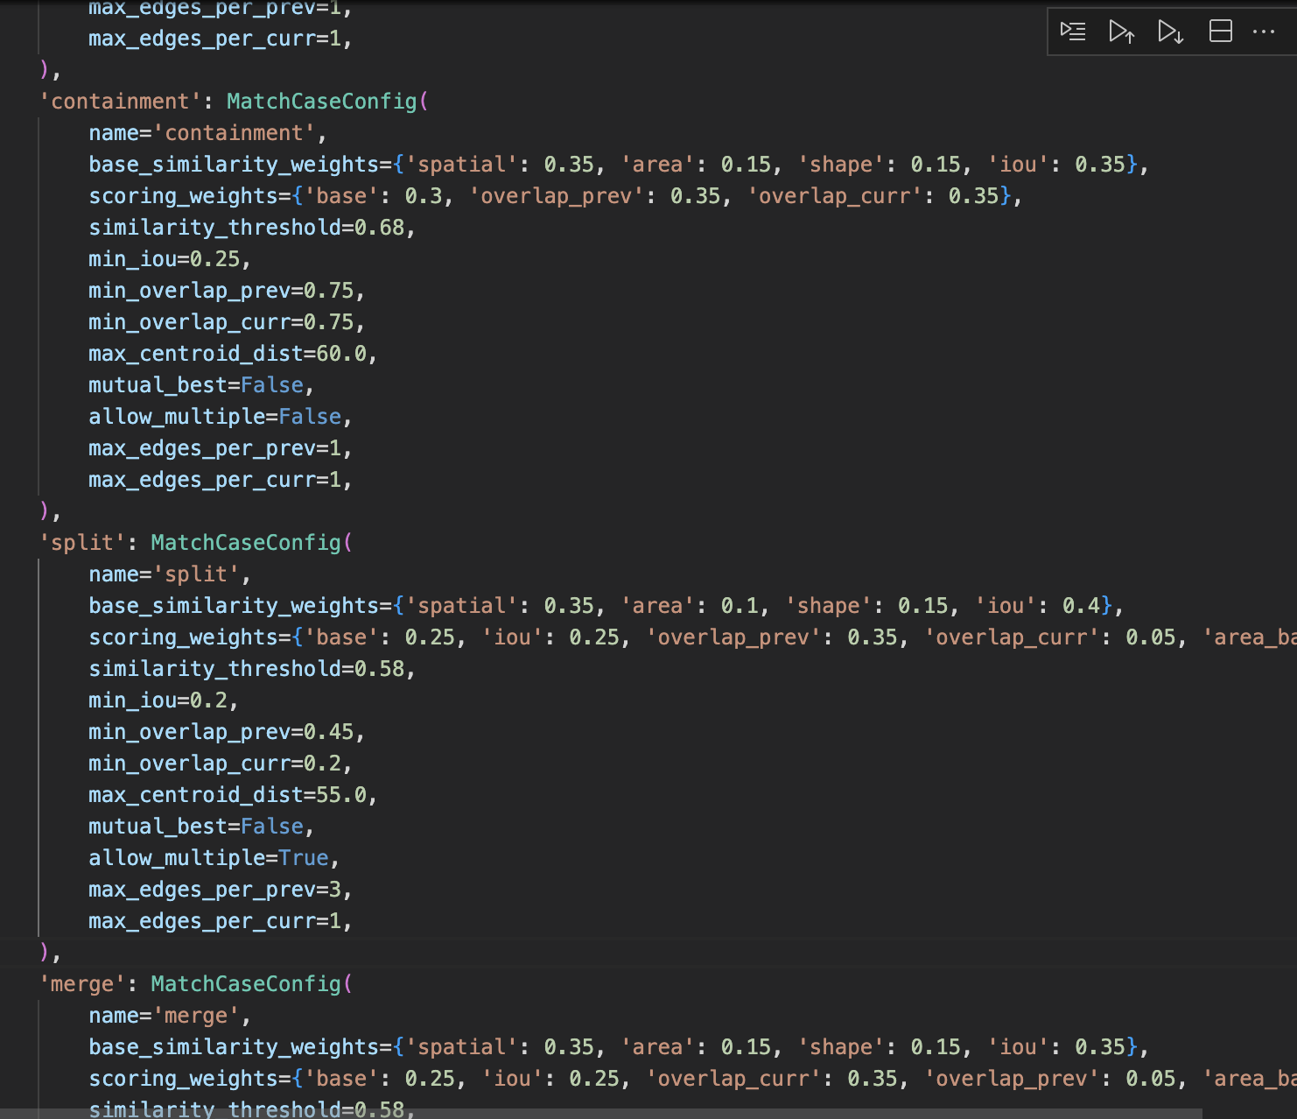
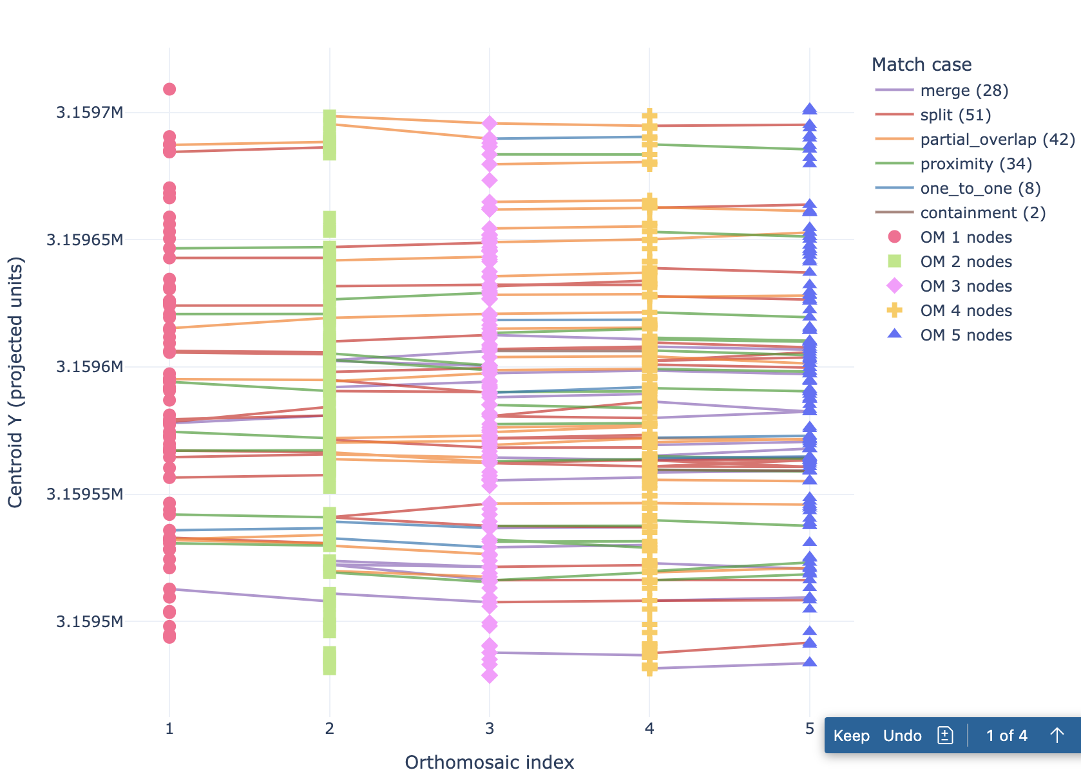
Previous Progress
Conditional threshold based matching
Classification of edges into different cases
We noticed that the tracking graph had less nodes initially and more in later orthomosaics

Slide 3
Shuffle Connectivity
For consecutive orthomosaics, we gather votes from each shuffle
If these 2 nodes are connected in a shuffle, vote += 1
We select the edge which has the maximum votes
Across all the shuffles, we also maintain a list for every node
This list contains all the nodes this nodes is connected to
If there is no edge leaving the current node, we check if this list has any node from the next orthomosaic in the get_tracking() function

Slide 4
Rotational Shuffles
We run the conditional matching algorithm on all the rotational shuffles of the orthomosaics
Eg: 1-2-3-4, 4-1-2-3, 3-4-1-2, 2-3-4-1
get_chains(): get a list of the chains that tree is a part of in all of the shuffles
We select the longest chain out of these, and sort according to time at which the orthomosaic was taken to get the matching chain

Slide 5
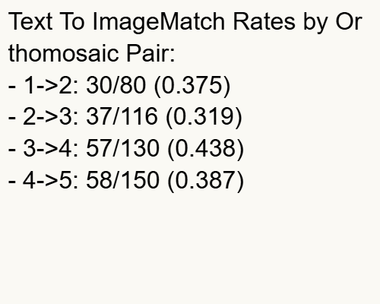
Problem
The results are not better than as shown:
Match Rates by Orthomosaic Pair:
- 5->3: 12/130 (0.092)
- 3->2: 11/116 (0.095)
- 2->4: 14/116 (0.121)
- 4->1: 9/80 (0.113)
Sorted orthomosaic results—>

Slide 6
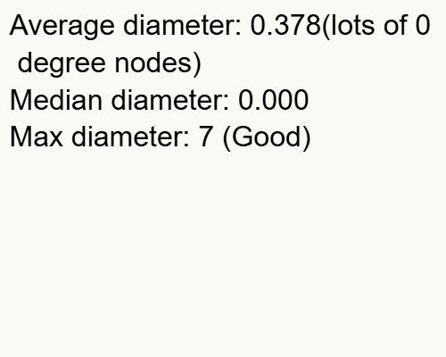
contd.
Average diameter: 0.021
Median diameter: 0.000
Max diameter: 1
Total Trees Detected: 626
Total Tracking Edges: 13
Overall Match Rate: 0.029
Average Chain Length: 1.02
Maximum Chain Length: 2
These results are quite poor as you can see, the maximum chain length we’re getting is only 2, and in some shuffled cases it reached 3, but never went up to 4 in any of the runs
Sorted orthomosaic results—>

Slide 7
Virtual Edges
These are edges between any two pairs of orthomosaics, they do not need to be consecutive
We iterate over the orthomosaics, and compare each new orthomosaic which all of the previous ones we have
We use the same conditional matching approach as earlier for creating virtual edges as well
If there is no edge leaving a node, we see if the node has a outgoing virtual edge connecting it to a node.
In get_tracking() we see the ancestors of this node(with both virtual and real edges) and select the chain greedily based on similarity scores

Slide 8
Problem
We are getting wrong matches as the errors propagate
We see that this algorithm produces chains with edges between nodes that have similarity scores lower than our set threshold

Slide 9
Future Ideas
Fix the matching algorithm to a simpler, high confidence only matches, and instead tune detectree2 parameters specific to each orthomosaic to have similar number of detected crowns across all orthomosaics

